Slide 1
Hidden Surface Removal
Course Code: CSC 3224
Course Title: Computer Graphics
Dept. of Computer Science
Faculty of Science and Technology
Lecturer No: | 12 | Week No: | 9 | Semester:
Lecturer:

Slide 2
Lecture Outline
Hidden Surface Removal
Painters Algorithm
Z- Buffer
BSP Tree

Slide 3
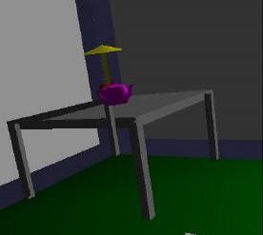
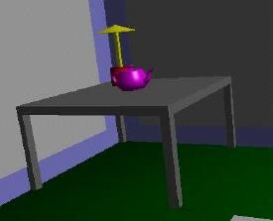
Why Hidden Surface Removal?
A correct rendering requires correct visibility calculations
When multiple opaque polygons cover the same screen space, only the closest one is visible (remove the other hidden surfaces)
wrong visibility
correct visibility

Slide 4
Why Hidden Surface Removal? (2)
We don’t want to waste computational resources rendering primitives which don’t contribute to the final image
Drawing polygonal faces on screen consumes CPU cycles
e.g. Illumination

Slide 5
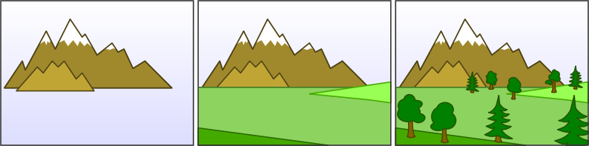
Painters algorithm
Draw surfaces in back to front order – nearer polygons “paint” over farther ones.
Need to decide the order to draw – far objects first

Slide 6

Painters algorithm
Key issue is order determination.
Doesn’t always work – see image at right.

Slide 7

Painters algorithm
Another situation it does not work
In both cases, we need to segment the triangles and make them sortable

Slide 8
Z-buffer
An image-based method applied during the rasterization stage
A standard approach implemented in most graphics libraries
Easy to be implemented on hardware
By Wolfgang Straßer in 1974

Slide 9
Z-buffer
Basic Z-buffer idea:
For every input polygon
For every pixel in the polygon interior, calculate its corresponding z value (by interpolation)
Compare the depth value with the closest value from a different polygon (largest z) so far
Paint the pixel with the color of the polygon if it is closer

Slide 10
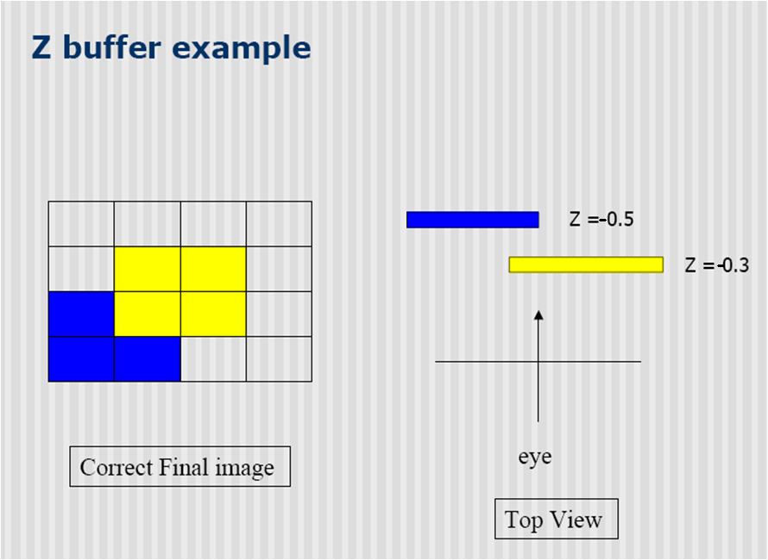
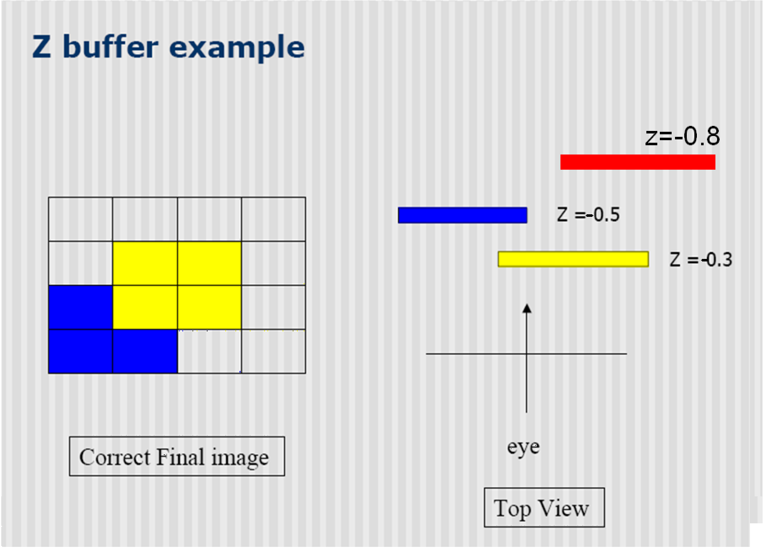
Z-buffer

Slide 11
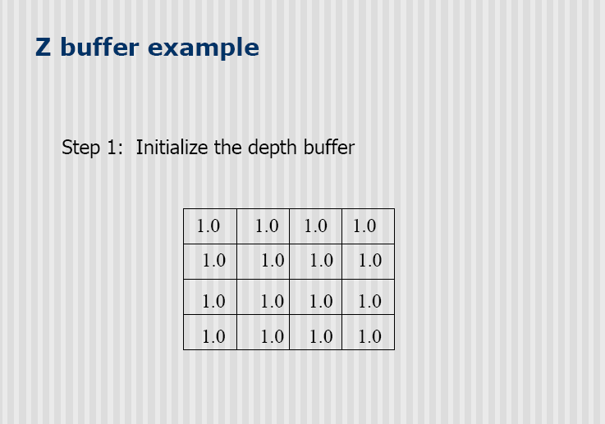
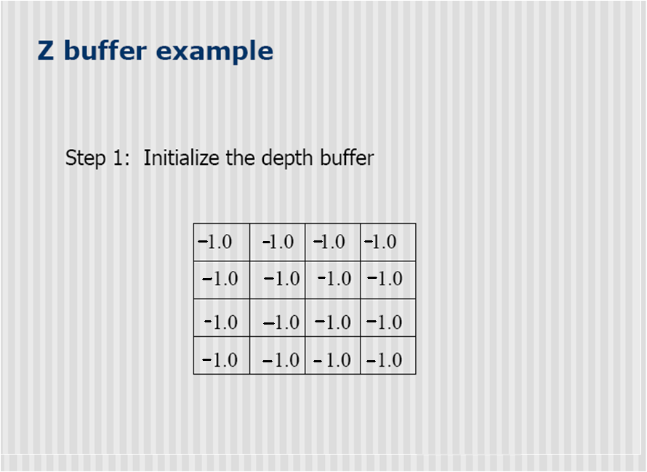
Z-buffer

Slide 12
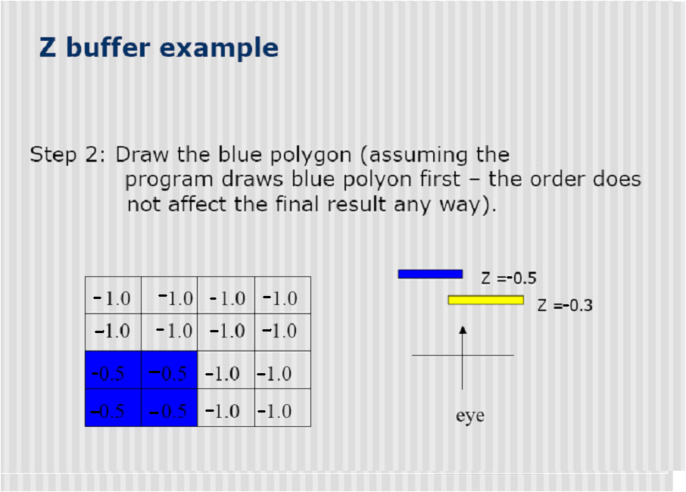
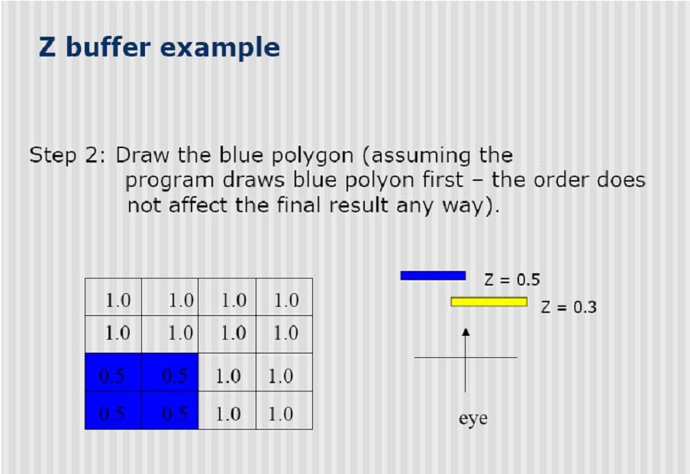
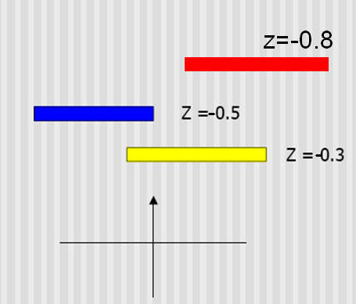

Z-buffer

Slide 13
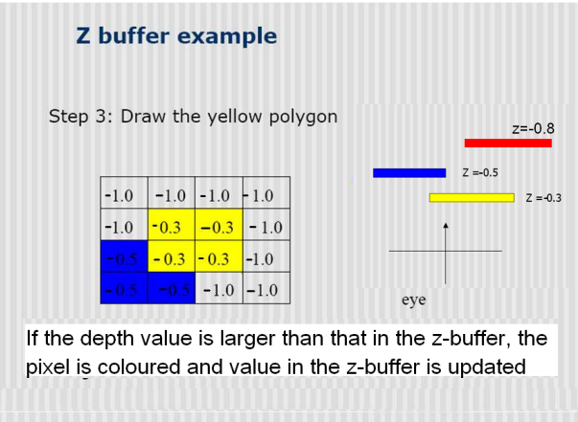
Z-buffer

Slide 14
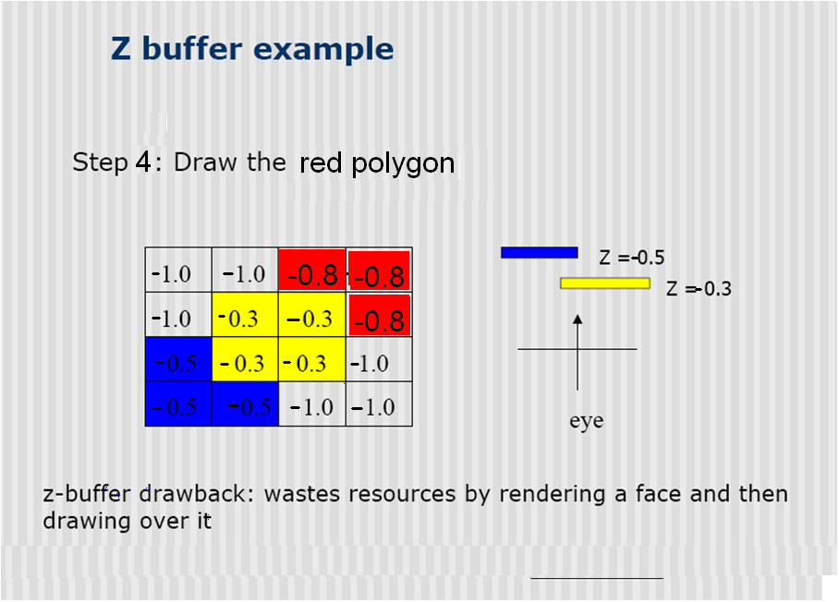

Z-buffer

Slide 15
Why is Z-buffering so popular ?
Advantage
Simple to implement in hardware.
– Memory for z-buffer is now not expensive
Diversity of primitives – not just polygons.
Unlimited scene complexity
No need to sort the objects
No need to calculate object-object intersections.
Disadvantage
Waste time drawing hidden objects
Z-precision errors (aliasing problems)

Slide 16
Z-buffer performance
Memory overhead: O(1)
Time to resolve visibility to screen precision: O(n)
n: number of polygons
Need to be combined with other culling methods to reduce complexity

Slide 17
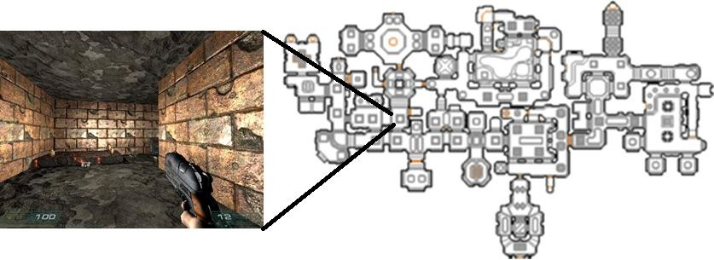
Z-buffer performance
What about for an environment shown below?
Very inefficient (many polygons behind the wall)

Slide 18
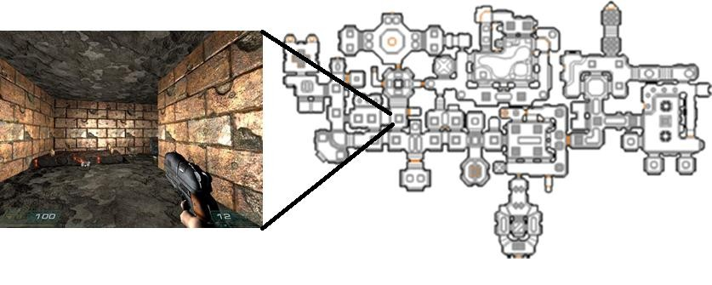
BSP (Binary Space Partitioning) Tree
We better sort the polygons according to the depth
And only draw those close to the viewer
Coming back to the painter’s algorithm
But doing a detailed scene analysis
Suitable for a scene below

Slide 19

BSP (Binary Space Partitioning) Tree
Choose polygon arbitrarily
5
Divide scene into front (relative to normal) and back half-spaces.
2
Split any polygon lying on both sides.
3
Choose a polygon from each side – split scene
again.
1
4
Recursively divide each side until each node contains only 1 polygon.
View of scene from above

Slide 20

BSP Tree
5
5a
5b
2
Choose polygon arbitrarily
3
Divide scene into front (relative to normal) and back half-spaces.
1
4
Split any polygon lying on both sides.
Choose a polygon from each side – split scene again.
front
3
back
Recursively divide each side until each node contains only 1 polygon.
4
1
5b
2
5a

Slide 21

BSP Tree
5
5a
2
5b
Choose polygon arbitrarily
Divide scene into front (relative to normal) and back half-spaces.
1
3
4
Split any polygon lying on both sides.
Choose a polygon from each side – split scene again.
front
3
back
Recursively divide each side until each node contains only 1 polygon.
2
4
front
5b
5a
1

Slide 22
BSP Tree
5
5a
2
5b
Choose polygon arbitrarily
3
Divide scene into front (relative to normal) and back half-spaces.
1
4
Split any polygon lying on both sides.
Choose a polygon from each side – split scene again.
front
3
back
Recursively divide each side until each node contains only 1 polygon.
2
4
front
5a
1
5b

Slide 23
Displaying a BSP tree
BSP tree can be traversed to yield a correct priority list for an arbitrary viewpoint.
Back-to-front : same as painter’s algorithm
Front-to-back : a more efficient approach

Slide 24
Displaying a BSP tree : Back to Front
.
Start at root polygon.
If viewer is in front half-space, draw polygons behind root first, then the root polygon, then polygons in front.
If viewer is in back half-space, draw polygons in front of root first,
then the root polygon, then polygons behind.
If polygon is on edge – either can be used.
Recursively descend the tree.
If eye is in rear half-space for a polygon can back face cull.
Always drawing the opposite side of the viewer first

Slide 25
Displaying a BSP tree : Front to Back
The back-to-front rendering will result in a lot of over drawing again
Front-to-back traversal is more efficient (Chen and Gordon, 1991)
Record which region has been filled in already
Terminate when all regions of the screen is filled in

Slide 26
Summary
Z-buffer is easy to implement on hardware and is a
standard technique for hidden surface removal
We need to combine it with an object-based method especially when there are too many polygons
BSP trees, portal culling

Slide 27
References
Foley et al. Chapter 15, all of it.
Introductory text, Chapter 13, all of it
Or equivalents in other texts, look out for:
(as well as the topics covered today)
Depth sort – Newell, Newell & Sancha
Scan-line algorithms
S. Chen and D. Gordon. “Front-to-Back Display of BSP Trees.” IEEE Computer Graphics & Algorithms, pp 79–85. September 1991.

Slide 28
Books
Foley, van Dam, Feiner, Hughes, Computer Graphics: principles and practice, Addison Wesley, Second Edition.
Schaum's Outline of Theory & Problems of Computer Graphics.
Peter Shirley Steve Marschner , “Fundamental of computer graphics”, Third Edition.

